Slide 1
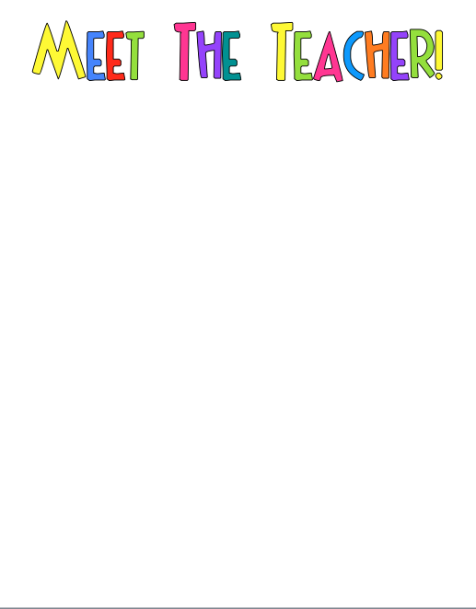
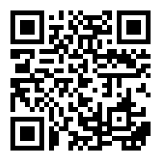
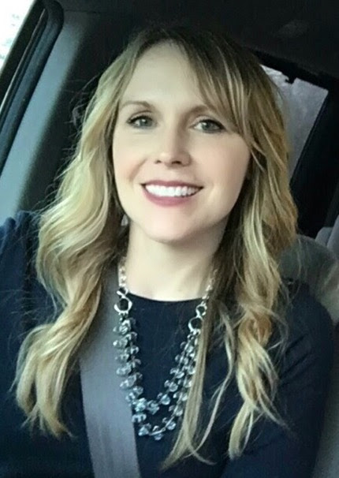
Hi! I am Mrs. Lowe. I am so excited to be your child’s teacher! This is my 4th year at MCES. I have taught first grade for 17 years and kindergarten for 2 years.
First grade is my passion! It never ceases to amaze me what first graders can do! They make so such incredible growth in one year. It is truly a magical experience. I enjoy teaching everything in first grade, especially reading. When children become readers, it opens up a whole new world. They are unstoppable and their future is limitless!
I am looking forward to an AMAZING year!!
Here is my contact information.
MY FAVORITES
Favorite Food: Salads, Pasta, Avocados
Favorite Drink: Coffee
Favorite Stores: TJ Maxx, Target, Loft, Amazon
Favorite TV Show: The Office
Favorite Food Places: Whole Foods, Caribou, First Watch, Moe’s
Hobbies: Watching my son play golf, watching my daughter dance,
Traveling, going to DPAC to watch Broadway shows
Favorite Treats: Dark Chocolate Justin’s Peanut Butter Cups, Vegan Oatmeal Cookies from Whole Foods

