Slide 1
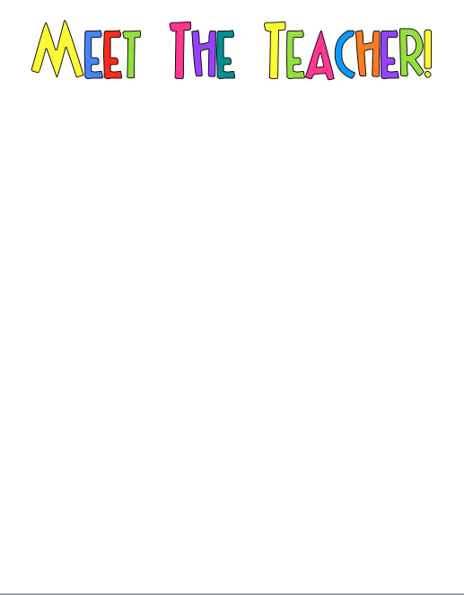
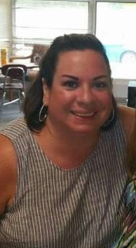
Hi! I am Ms. Taylor! I am so excited to be teaching 1st grade for the 15th year! I have been at Middle Creek for 15 years and I also have taught 2nd grade in another county of North Carolina. I love to spend time with my friends and family when I have free time. I was born and raised in Raleigh but now live in Fuquay. Some of my favorite things are reading, daisies, Target, and coffee!
I can’t wait for you to enjoy 1st grade as much as I do!!
MY FAVORITES
Food: Pasta
Color: Green
Drink: Coffee or Cherry Coke
Season: Fall
Sports Team: UNC Tarheels
Fast Food: Chickfila
Favorite store: Target

