Slide 1
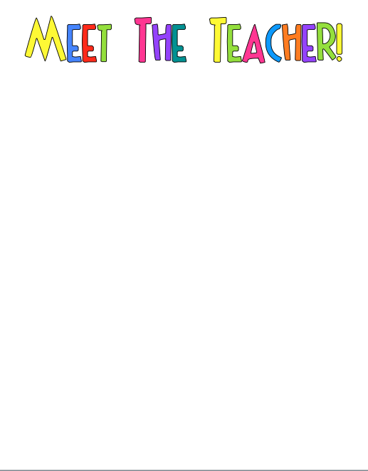
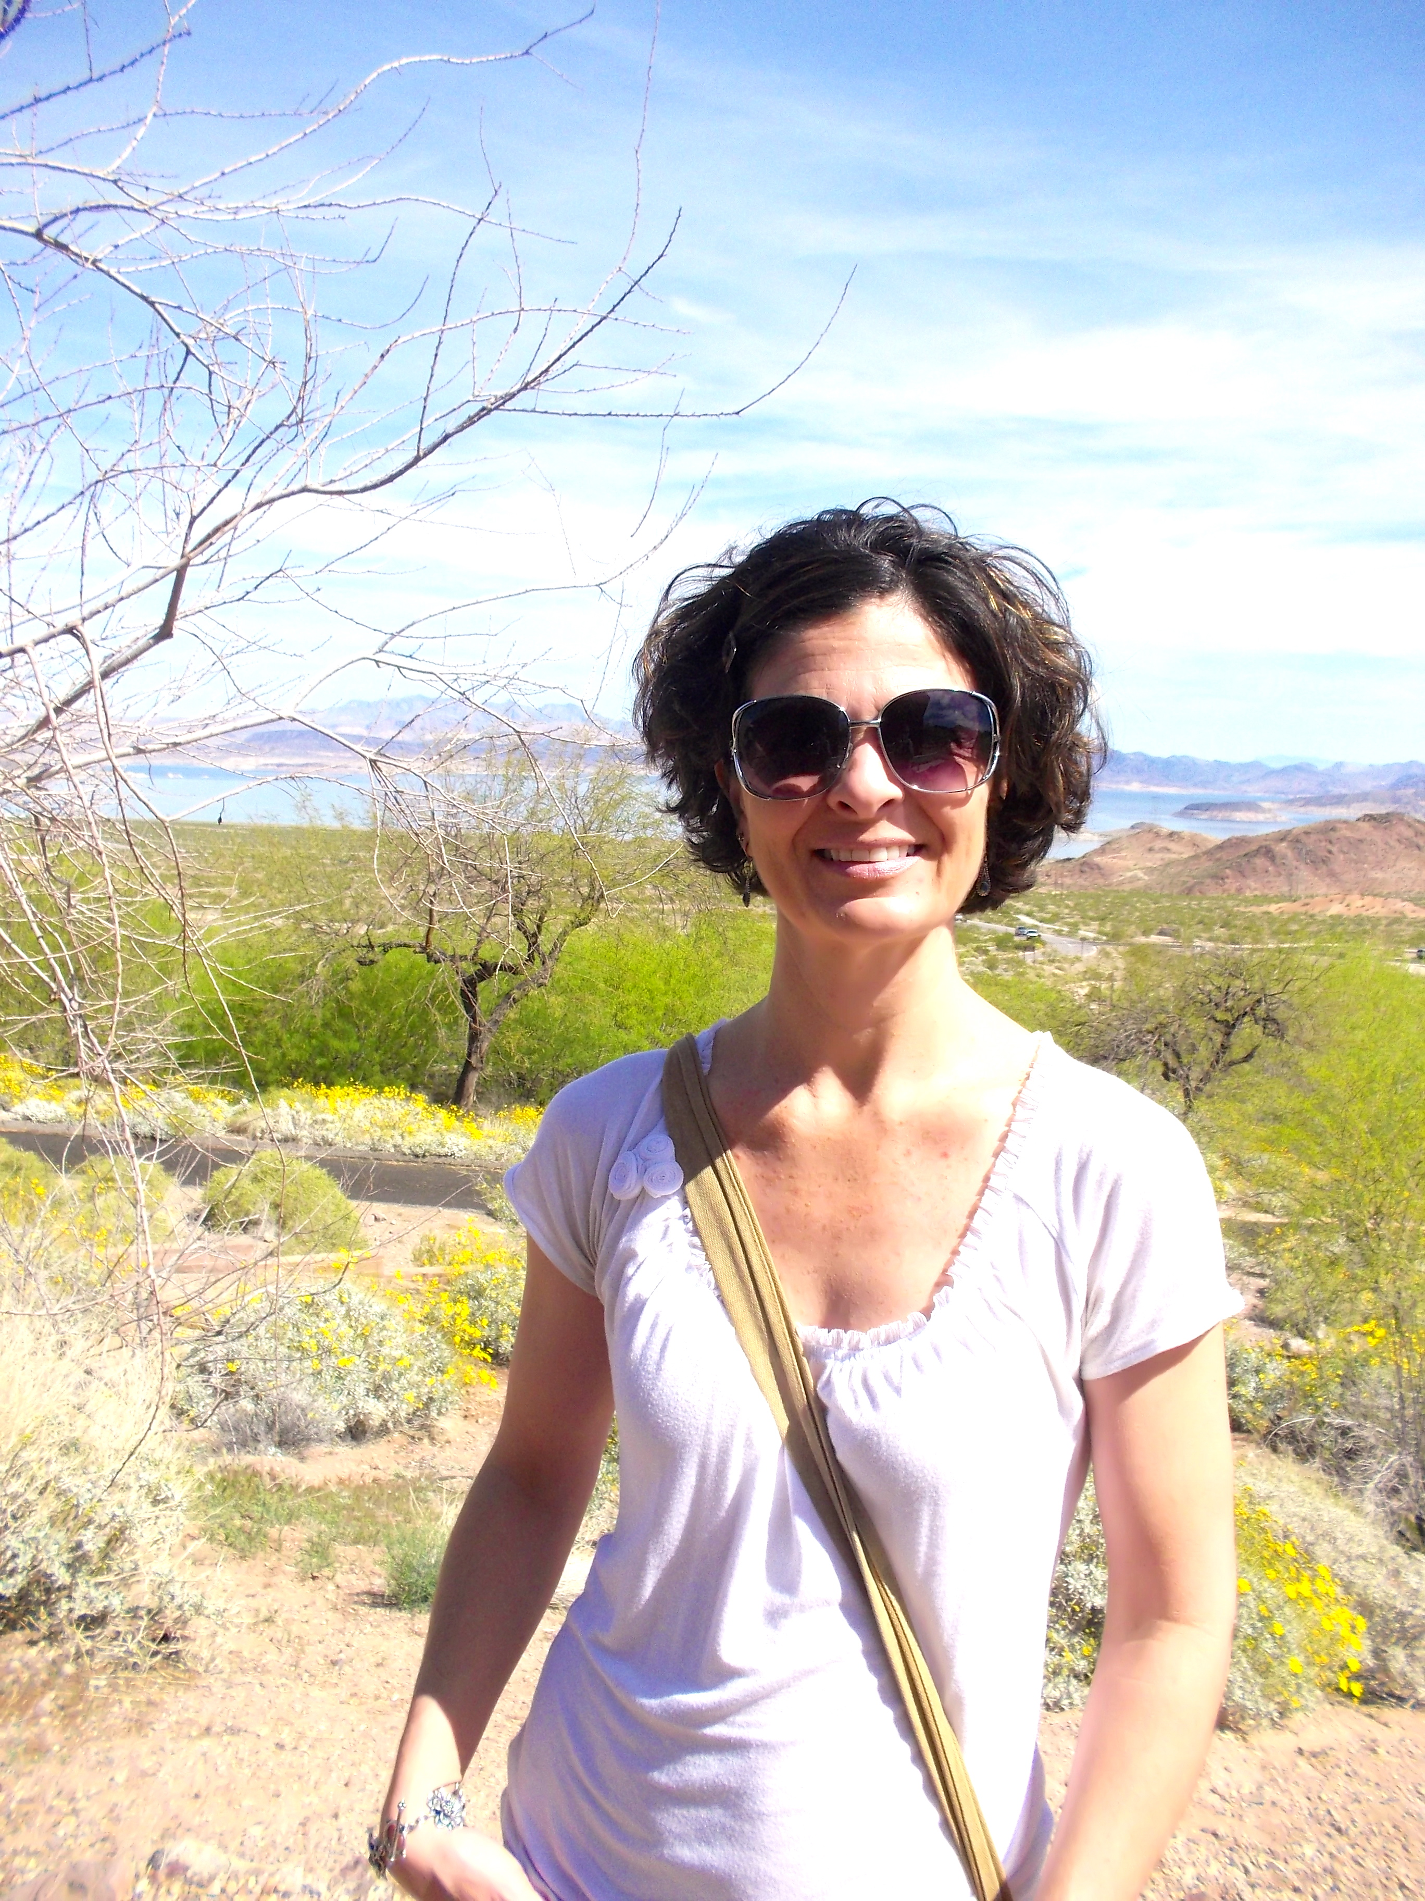
Hi! I am Mrs. Atcheson. I am so excited to be your child’s teacher! This is my 5th year at MCES. I have taught first grade for 6 years and kindergarten for 17 years.
I am originally from Charleston, West Virginia but have lived in North Carolina ever since graduating from ECU (Go Pirates!) in 1994! I enjoy spending time with my husband, children, and fur babies. In my spare time I love to garden and spend as much time as possible at the beach.
I can’t wait to begin a wonderful year of learning and growing together at MCES! I am looking forward to an AMAZING year!!
MY FAVORITES
Drinks: Sweet tea, Sparkling water
Stores: Target, Loft, Lowes Hardware, Kohl’s
TV Show: HGTV
Favorite Food Places: Panera, Starbucks, and Moe’s
Hobbies: Reading, gardening (I love indoor plants too!!)
Sports Team: Denver Broncos
Color: Yellow

